Slide 1
The Kindergarten Program
A Program to Support
Learning and Teaching
in Kindergarten

Slide 2

Welcome!
You are your child’s first and most important teacher and we want to learn from you as we get to know your child.
Notes:
**The video links below are provided as references and as resources for educators. They are not meant to be part of the presentation itself.
Consider welcoming parents with opening words like these:
“This year we are going to learn together, to get to know your children.”
From Why is it Important?
Video on http://www.edu.gov.on.ca/childcare/engage.html
OR
“As we get to know your children we invite you to make our understanding of your child more complete.”
Adapted from Parent Engagement - Parents as Active Participants in Early Years Programs
Video on http://www.edu.gov.on.ca/childcare/engage.html

Slide 3
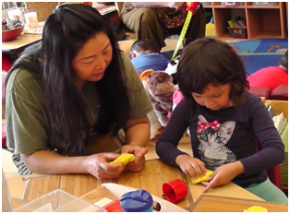
Family Partnerships
Participation in your child’s learning is encouraged
Please consider:
  Sharing your child’s unique strengths, interests, and learning preferences
  Engaging your child in conversations about his/her classroom learning experiences
  Sharing learning from home
Notes:
As outlined in our Early Years strategy, we view families as their child’s first teacher
“Children thrive in programs where they and their families are valued as active participants and contributors.” How Does Learning Happen?

Slide 4
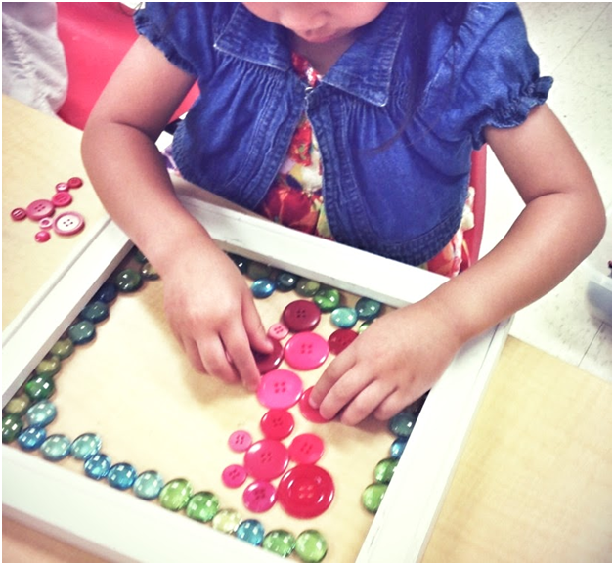
Play-Based Learning
Children come to school competent, curious and rich in experiences
Children and their educators learn together by:
  exploring
  investigating
  creating
Notes:
In a play based-learning environment:
Children explore open-ended materials in a variety of ways to:
Expand their natural curiosity, creativity, inquiry, and imagination
Develop problem solving, abstract reasoning, and collaboration skills
Educators interact with children during play to extend their thinking and support the development of early literacy and mathematics behaviours
These experiences expand each child’s natural curiosity, creativity, inquiry, and imagination; and develop problem solving, abstract reasoning, collaboration, and communication skills.
As children and educators engage in play-based learning and teaching together, the foundations of early literacy and mathematics are built. Educators observe, listen, question and guide children to promote their growth as independent learners.

Slide 5
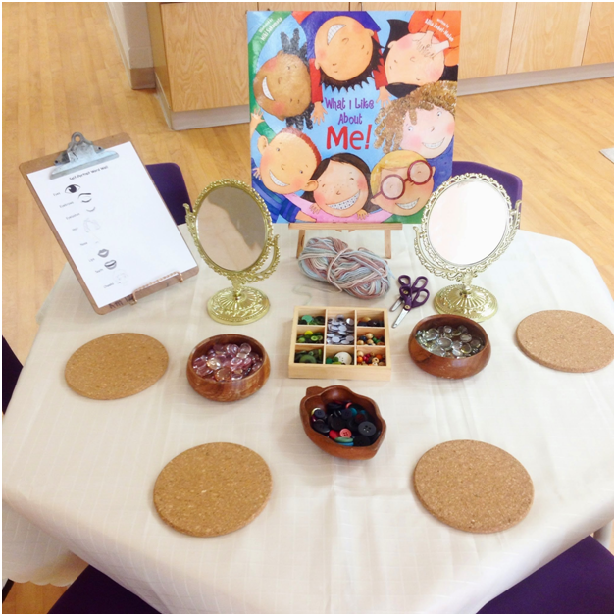
Kindergarten is for
All Children
Educators consider each child’s:
Background/experience
Stage of development
Special education needs
Stage of second language acquisition
Families and educators work together to ensure that
all children experience success!
Notes:
Children entering Kindergarten come with different backgrounds and experiences and are at different stages of development.
the learning environment, contexts for learning, and pedagogical strategies will be adjusted to meet the particular needs of each child (as per p. 50 of The 2016 Kindergarten Program document).
Ongoing sharing of information about your child will help us plan for your child’s learning
“All students can succeed. Each student has his or her own unique patterns of learning.” Learning for All, K-12, 2013

Slide 6
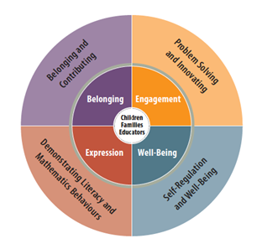
The Four Frames of the Kindergarten Program
The Kindergarten Program, 2016, p. 14
Notes:
In kindergarten, the learning expectations are organized into four frames, or broad areas of learning
Belonging and Contributing
Problem Solving and Innovating
Demonstrating Literacy and Mathematics Behaviours
Self-Regulation and Well-Being
The frames encompass areas of learning for which four- and five-year-olds are developmentally ready (p. 14 of The 2016 Kindergarten Program)
When children play, they naturally engage in these four areas of learning
Educators co-construct the learning with children across all four frames
The frames are outlined in the next several slides
*Resources that a school team may want to have available:
A couple of copies of the Ministry document, The Kindergarten Program, 2016 available for parents to look at
Page 28 of the document has links to other parent resources that you may choose to have available
Copies of the YRDSB Early Years Strategy
Copies of the YRDSB Brochure: Understanding the Kindergarten Program for Families

Slide 7
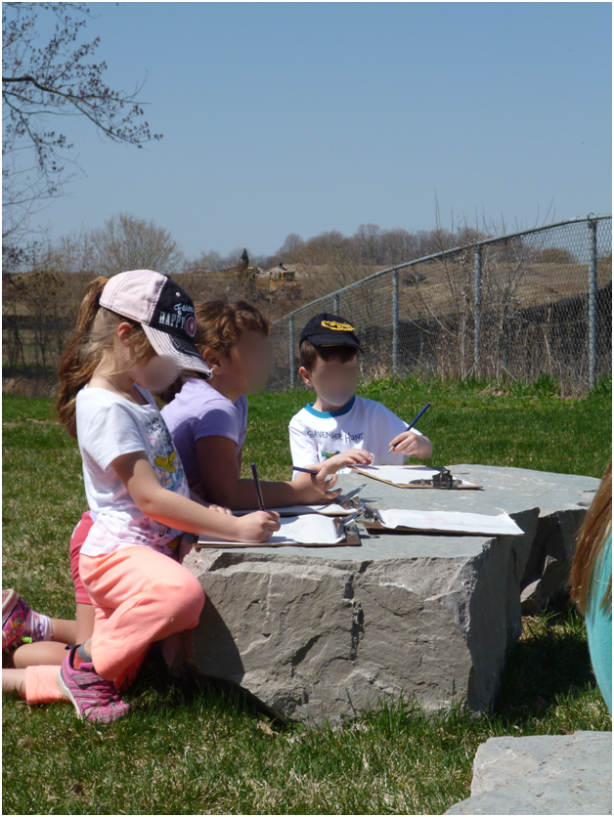
Belonging and Contributing
As children play, educators focus on their...
Sense of connectedness to others
Ability to form relationships and make contributions as part of:
  a group
  a community
  the natural world
Notes:
Here the children are working together to make a plan for caring for a new tree.

Slide 8
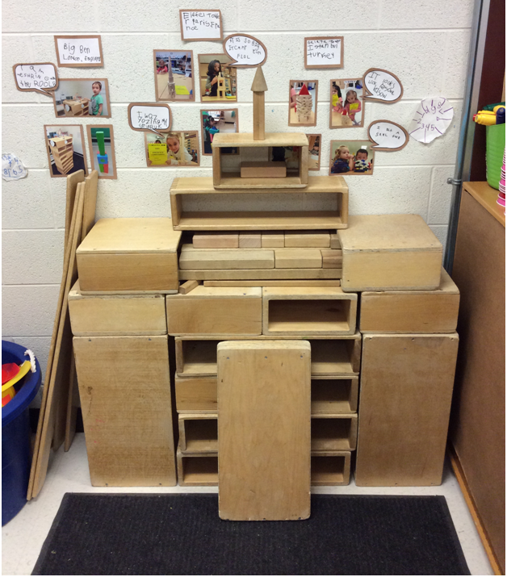
Belonging and Contributing…
at the building and construction area
Learning might look and sound like:
A group of children using blocks to create a replica of a building after talking and thinking about different kinds of buildings
“Fatima helped me pick up the blocks.”
“Can you help us find another way
to make this?”
Notes:
The building and construction area is one of many areas in which children develop their sense of belonging and contributing

Slide 9
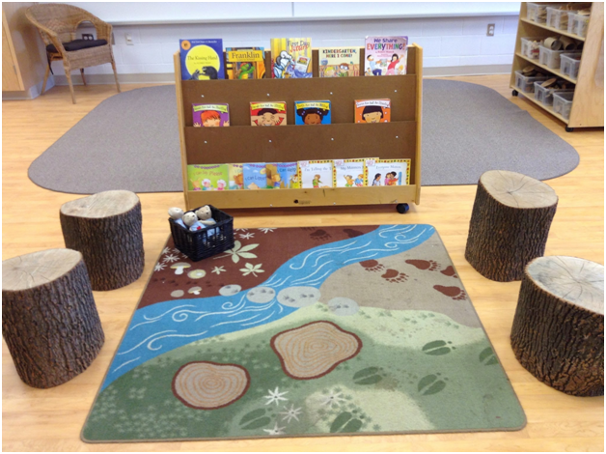
Self-Regulation and Well-Being
As children play, educators focus on their...
Ability to understand their own thoughts and feelings
Ability to understand and manage emotions and impulses
Awareness of their physical and mental health and wellness
Notes:
This frame includes a child’s awareness of his or her physical and mental health and wellness.
What children learn in connection with this frame allows them to focus, to learn, to respect themselves and others, and to promote well-being in themselves and others.
( The Kindergarten Program: Learning Module The Four Frames)
This photograph shows how the educators use materials and the classroom set up to help children develop self-regulation skills

Slide 10
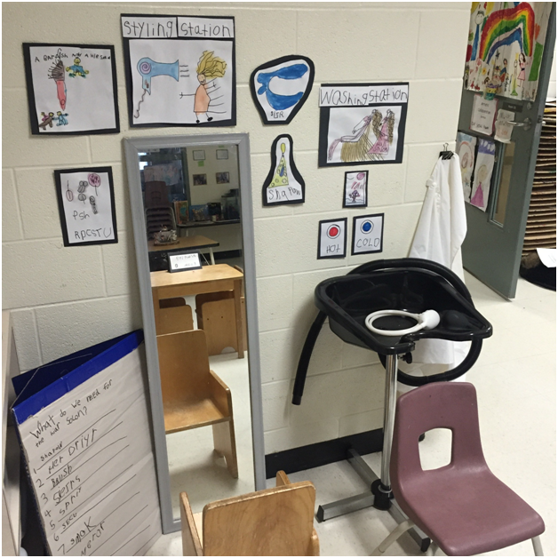
Self-Regulation and Well-Being…
at the dramatic play area
Learning might look and sound like…
Two children are playing in the dramatic play area. One child is rubbing the doll’s back saying, “It’s okay. Don’t cry.” The other child says, “I think she’s nervous about getting her hair done.”

Slide 11
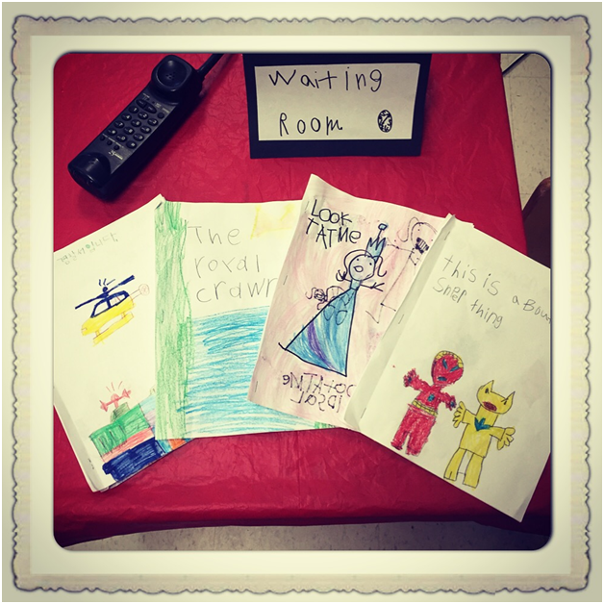
Demonstrating Literacy and Mathematics Behaviours
As children play, educators focus on their...
“Literacy behaviours” - the various ways children respond to words and stories, begin to think critically, and begin to read and write
Notes:
Literacy and Mathematics are connected to real-life, relevant and authentic contexts.
There are opportunities throughout the day for children to be actively engaged in learning about literacy and mathematics and a developing the love of learning…..
(The Kindergarten Program: Learning Module The Four Frames)
In this photo children have created magazines for the waiting room at their doctor’s office

Slide 12
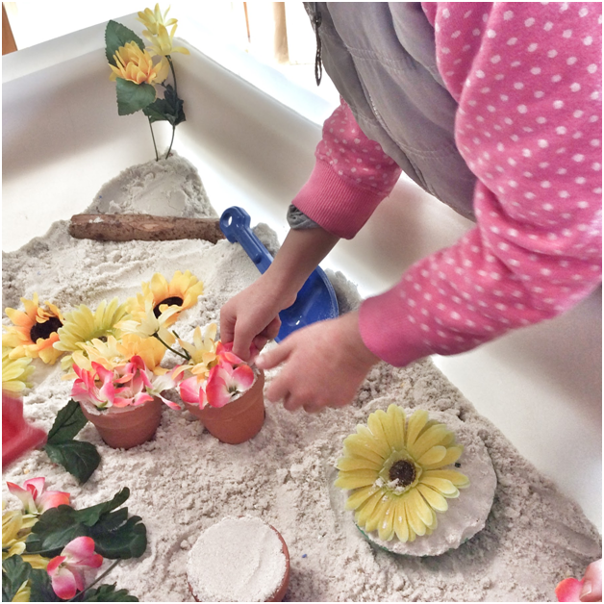
Demonstrating Literacy and Mathematics Behaviours...at the sand table
Learning might look and sound like…
Children retelling the story of The Tiny Seed, a book they have just heard in a read aloud
They use materials that have been intentionally placed at the sand table

Slide 13
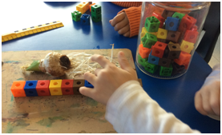
Demonstrating Literacy and Mathematics Behaviours
As children play, educators focus on their...
“Mathematics behaviours” - the various ways in which children learn more about mathematical relationships, concepts, skills,
and processes
Notes:
In this photo the child is using counting and measuring skills to tell how long the bulb is

Slide 14
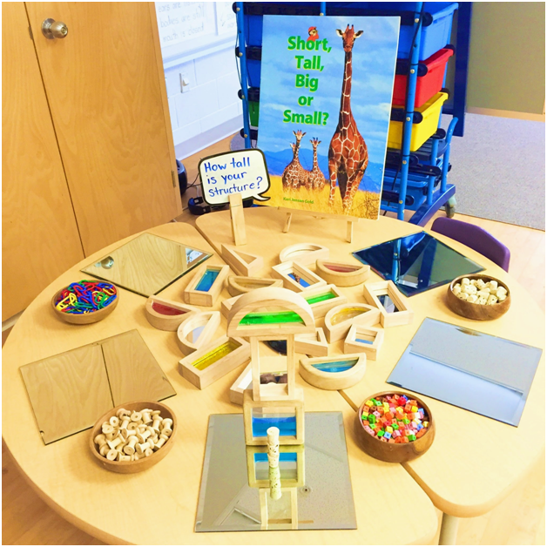
Demonstrating Literacy and
Mathematics Behaviours...with building materials
Learning might look and sound like…
A group of children use cubes or spools to measure their structures after reading Short, Tall, Big or Small?
“My structure is 12 spools tall.”

Slide 15
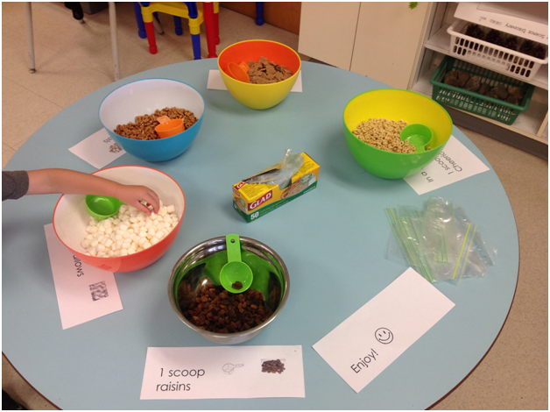
Demonstrating Literacy and
Mathematics Behaviours...in the snack area
Learning might look and sound like…
Children create their own trail mix by adding one scoop of each ingredient to their bags.
“I know that says 1 scoop”
Notes:
This is an example of a learning opportunity that involves both literacy and mathematics behaviours.

Slide 16
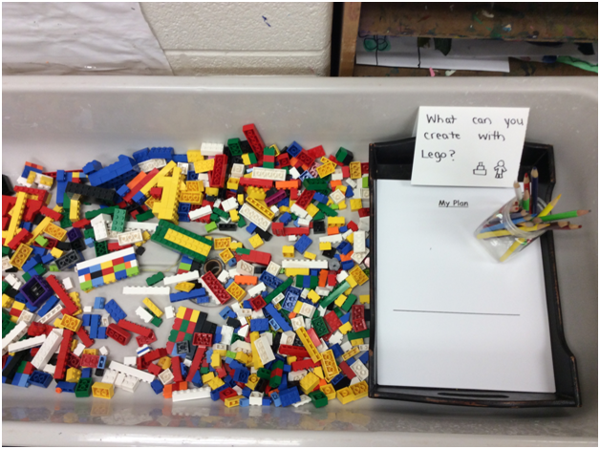
Problem Solving
and Innovating
As children play, educators focus on their...
Desire to make meaning of their world by asking questions, testing theories, solving problems, and using creative and analytical thinking
Confidence to explore the innovative thoughts and activities that naturally arise with an active curiosity
Notes:
Children have opportunities to problem solve in all contexts.
They develop the habit of applying creative, analytical and critical thinking skills in all aspects of their lives.
(The Kindergarten Program: Learning Module The Four Frames)

Slide 17
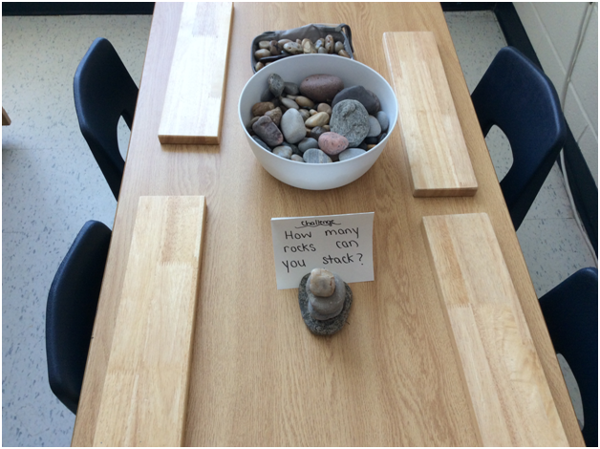
Problem Solving and Innovating...with natural materials
Learning might look and sound like…
“We made our stack wider at the bottom so that we could build it taller. Now it doesn’t fall down.”
Children draw and label a picture of the finished tower to show their solution

Slide 18
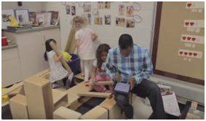
How Your Child’s
Learning is Assessed
The four frames are used to structure learning and assessment
Your child’s learning and development will be documented throughout the year
Documentation may include photographs, video clips, conversations, and your child’s work
The ongoing collection of your child’s learning will be
shared with you over the course of the year
Notes:
The frames reflect the integrated way in which learning occurs during children’s play and inquiry in kindergarten (The Kindergarten Program, 2016).
Your child’s work may be paintings, drawings, writing, etc.
The photo shows an educator using an iPad to document student learning during play in the building area
***Let parents know how their child’s work might be shared with them

Slide 19
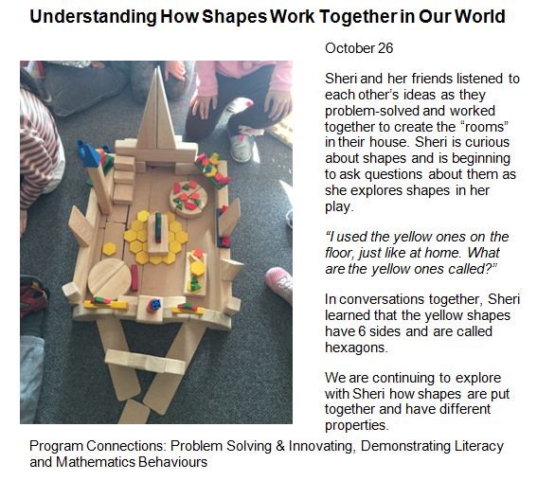
Pedagogical
Documentation:
Making Thinking Visible
Notes:
This is an example of pedagogical documentation that might be sent home with your child
Sending home the pedagogical documentation makes the learning visible

Slide 20
Fall 2016: In-Class Observation Visits and Progress Reports
Year 1 Students:
You will be invited to an Observation Visit
In-class observation form will be shared
Year 2 Students:
Progress reports will be sent home
You will be invited to participate in a meeting with
your child’s educator(s)
Notes:
This slide can be removed for the 2017-2018 school year.
Year 1 (formerly JK)
Year 2 (formerly SK)
Depending on when the meeting is scheduled, either the teacher or both the teacher and DECE will be able to participate in the meeting with parents.
Let parents know that they will have the opportunity to:
observe their child engaged in learning in his or her classroom.
see their child engaged in a variety of learning experiences with his or her peers and classroom educators
briefly discuss your observations or to ask any questions that you might have.

Slide 21
Formal Communication
of Learning
Kindergarten Communication of Learning for Year 1 and Year 2 students
Written comments shared in February (Term 1) and
June (Term 2)
Learning will be summarized using the four frames for learning
Key learning, growth in learning and next steps in learning will be described within each frame
Notes:
Let parents know that they will be able to contribute to the Communication of Learning by completing and returning the tear-off section
They will have the opportunity to comment on:
Growth they have noticed in their child’s learning
How they will continue to help their child with his/her learning

Slide 22
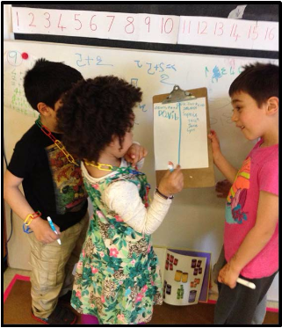
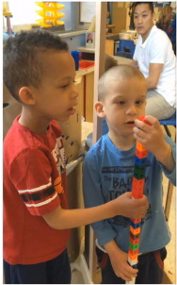
The Power of
Play-Based Learning
“Play nourishes every aspect of children’s development ...Play develops the foundation of intellectual, social, physical, and emotional skills necessary for success in school and in life.”
(Canadian Council on Learning, 2006, as cited in
The Kindergarten Program 2016, p. 18)
Notes:
This quote came from the edugains parent information sheet about play-based learning. http://www.edugains.ca/resourcesKIN/SchoolLeader/BuildingRelationships/Play.pdf
Below is the link to additional parent information sheets available on edugains:
http://www.edugains.ca/newsite/Kindergarten/schoolleader/parent_info_sheets.html

Slide 23

Questions

